Slide 1
2Market DB1

Slide 2
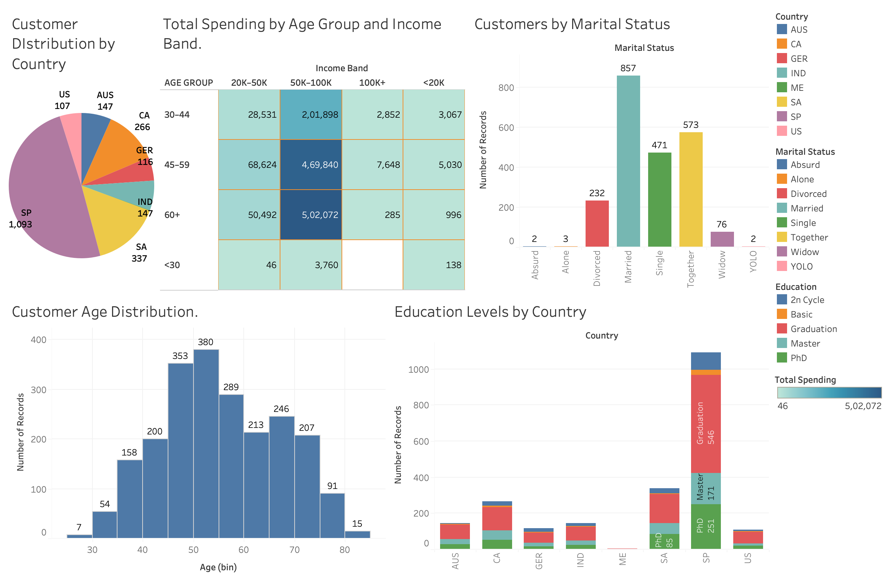

Slide 3
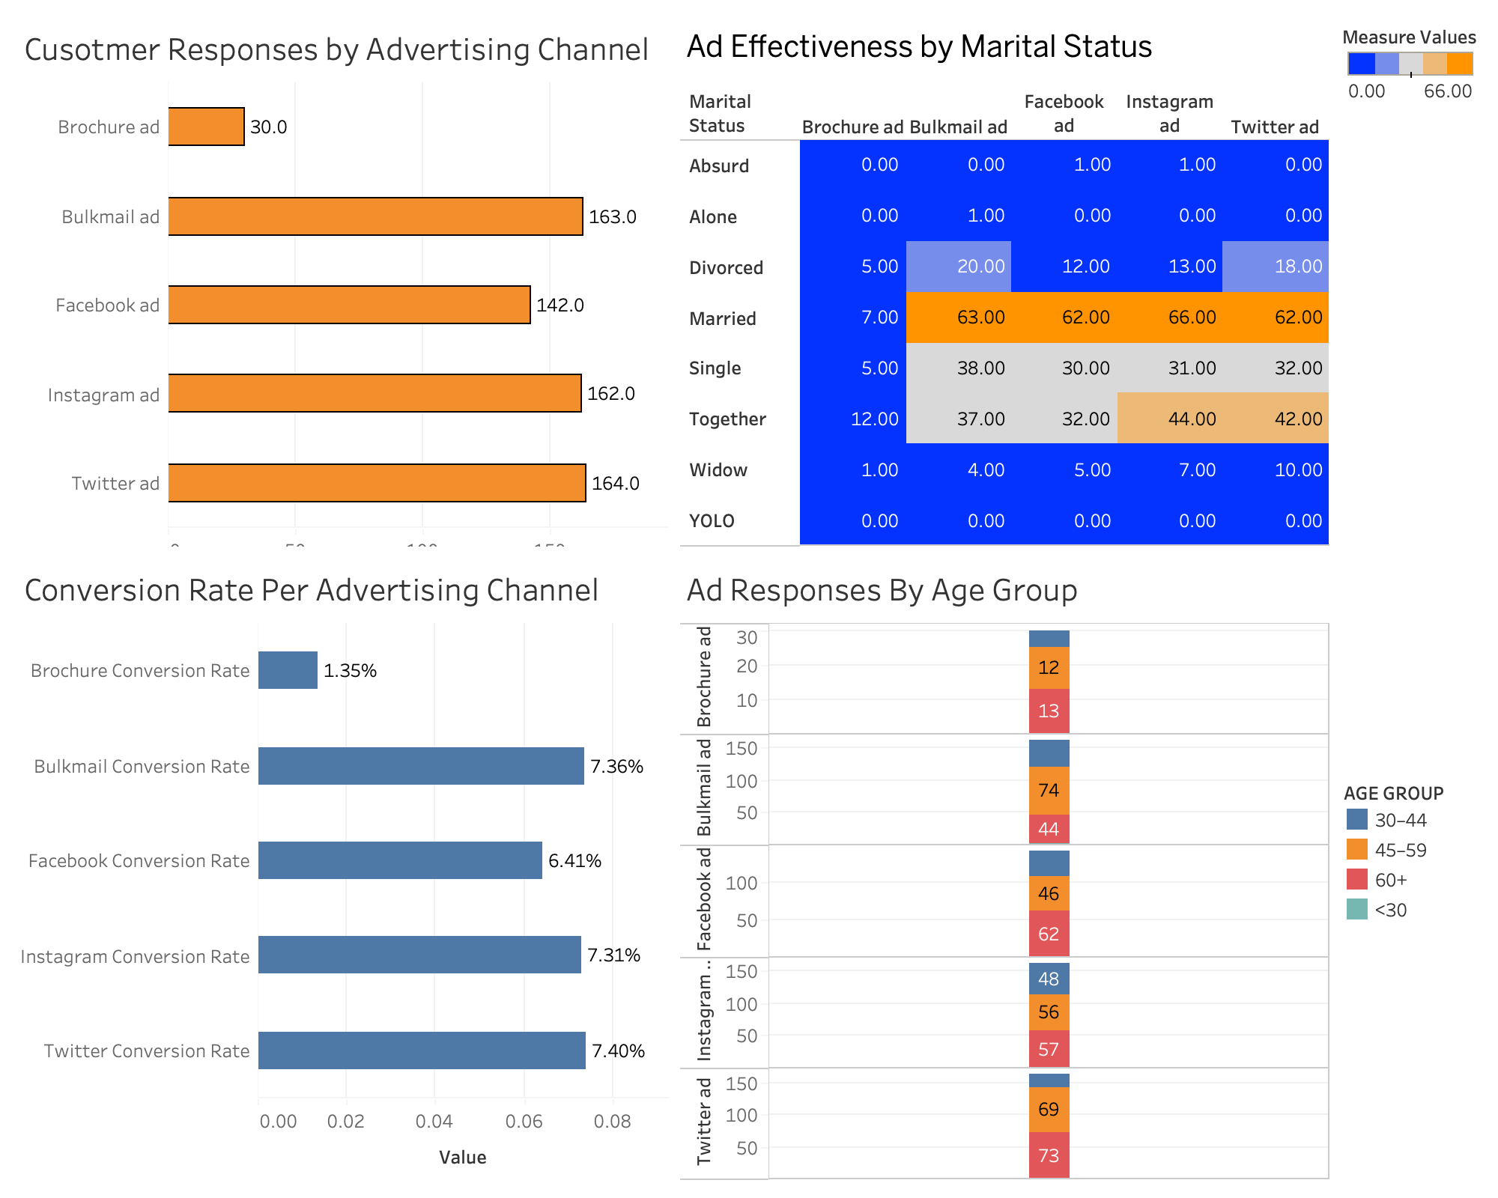

Slide 4
